Slide 1
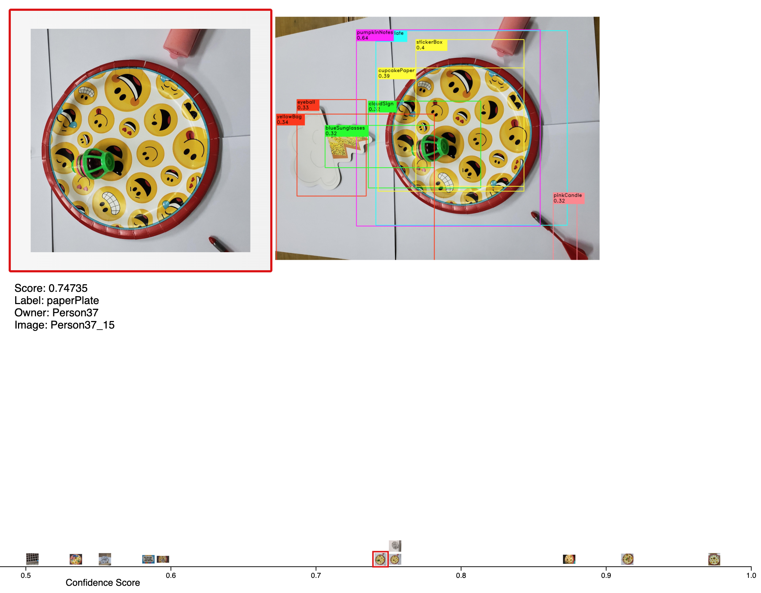

Slide 2
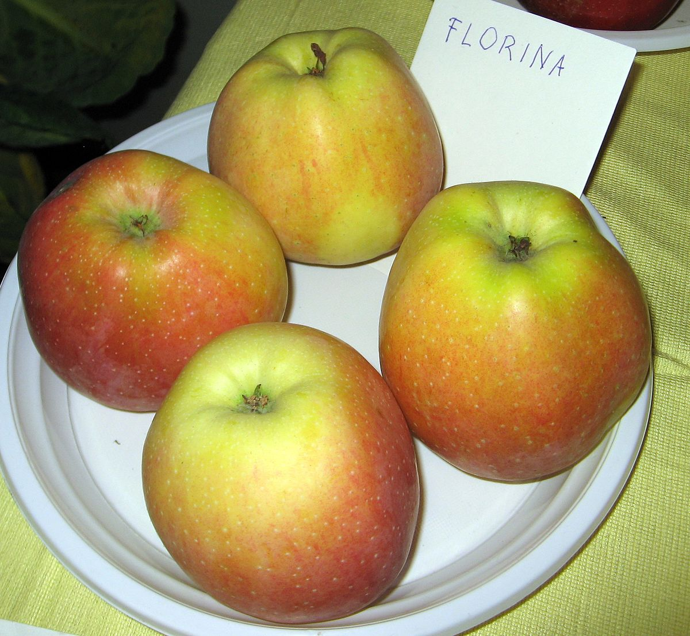
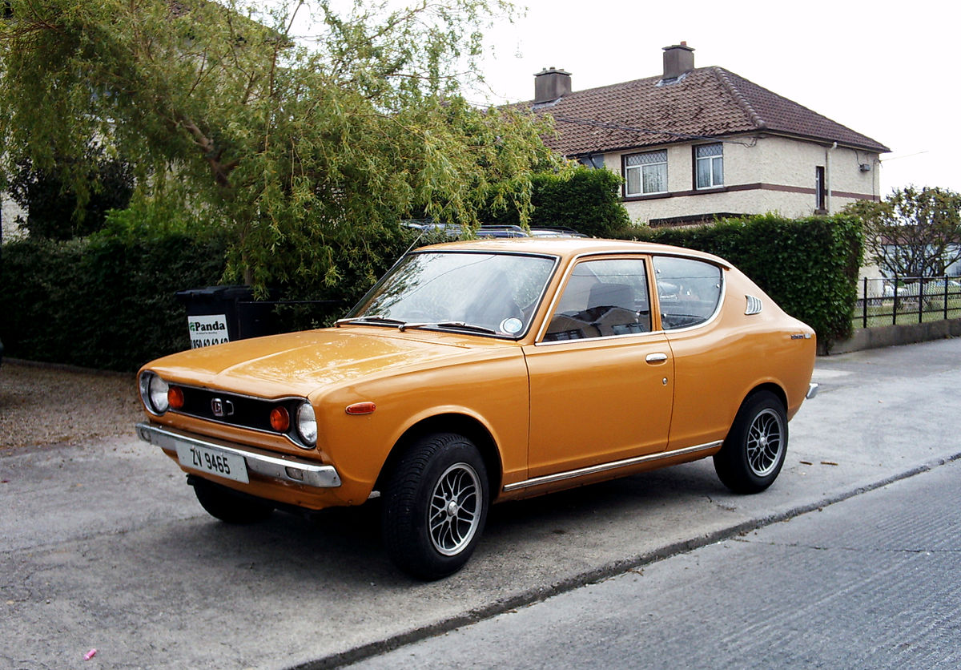
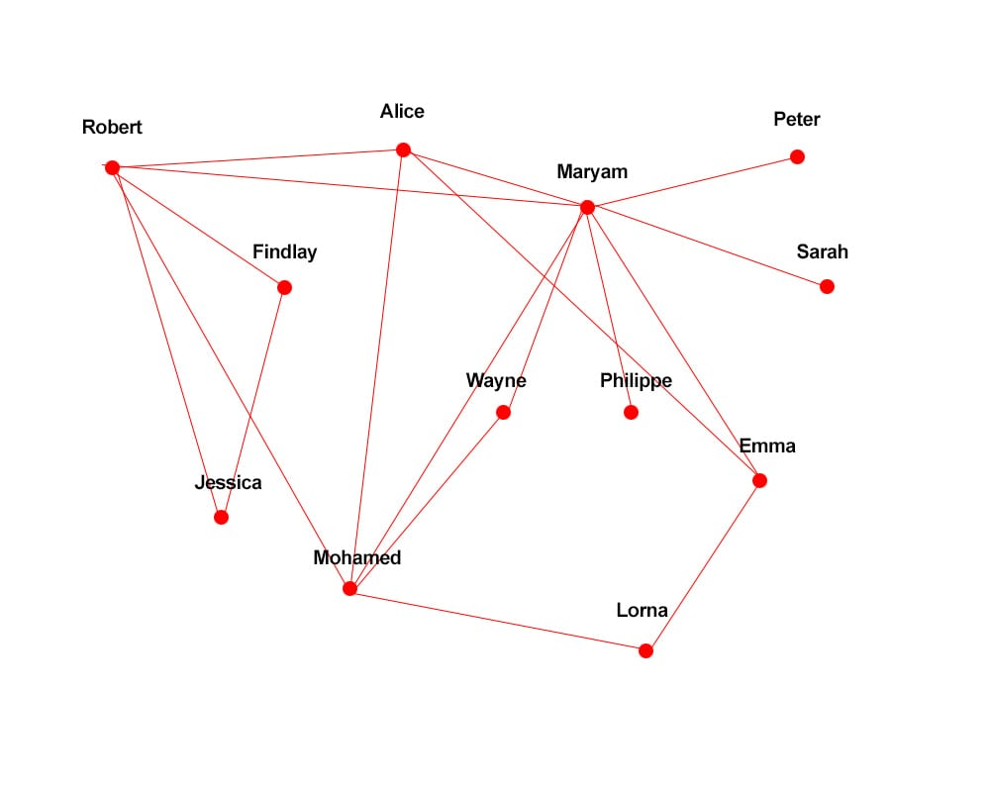
Examine objects
Label images
Image 1
Image 2
Image 3
Image 4
Image 5
Image 6
…
Horse
Car x
House x
Dice
Bag
Glasses
…
…
List Commonly mistaken labels
Plot Precision - Recall
Weight = Sum of confidence score*

Slide 3
Uncertainty/Confidence
Understand results
Examine objects
Label obj TP/FP
Precision
Plot Precision - Recall
Track provenance
Evaluate classifier
List Commonly mislabels objects
Recall
Help to recommend
Re-label images
Label FN
Uncertainty/Confidence
Improve results

Slide 4
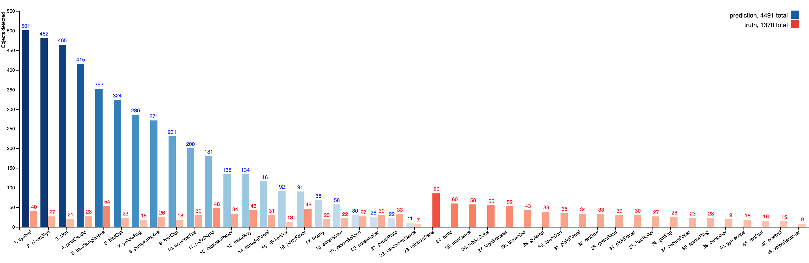
731 / 1370 = 53%

Slide 5
Group: Classifiers detect objects |  |  |  | Group: Classifiers cannot detect objects
Rank | Class name | AP (%) |  | Rank | Class name | AP (%) | Penalty
1 | blueSunglasses | 36.24 |  | 23 | voiceRecorder | 0 | 9
2 | paperPlate | 30.7 |  | 24 | cowbell | 0 | 15
3 | yellowBalloon | 28.7 |  | 25 | redDart | 0 | 16
4 | pumkinNotes | 25.01 |  | 26 | gyroscope | 0 | 18
5 | metalKey | 20.97 |  | 27 | carabiner | 0 | 19
6 | stickerBox | 20.46 |  | 28 | spiderRing | 0 | 23
7 | cupcakePaper | 17.88 |  | 29 | cactusPaper | 0 | 23
8 | partyFavor | 17.3 |  | 30 | giftBag | 0 | 26
9 | vancouverCards | 16.88 |  | 31 | hairRoller | 0 | 27
10 | noisemaker | 14.93 |  | 32 | pinkEraser | 0 | 30
11 | canadaPencil | 12.09 |  | 33 | glassBead | 0 | 30
12 | redWhistle | 11.86 |  | 34 | redBow | 0 | 33
13 | eyeball | 10.88 |  | 35 | plaidPencil | 0 | 34
14 | sign | 9.4 |  | 36 | foamDart | 0 | 35
15 | silverStraw | 8.64 |  | 37 | gClamp | 0 | 39
16 | cloudSign | 8.6 |  | 38 | brownDie | 0 | 43
17 | lavenderDie | 8.21 |  | 39 | legoBracelet | 0 | 52
18 | yellowBag | 7.57 |  | 40 | rubiksCube | 0 | 55
19 | hairClip | 6 |  | 41 | miniCards | 0 | 58
20 | birdCall | 5.75 |  | 42 | turtle | 0 | 60
21 | pinkCandle | 4.37 |  | 43 | rainbowPens | 0 | 86
22 | trophy | 0.41

